Slide 1

Generating Top-down View from 6 Stereo Images
Muhammad Osama Khan
Muhammad Muneeb Afzal
Divya Juneja
Notes:
Hi everyone. This is a joint work by myself, Muneeb and Divya.

Slide 2
Road Segmentation –Architectures
Decoder Architectures
Upsampling + Convolutions | Transposed Convolutions
0.733 | 0.741
6 Encoders (shared weights) + Decoder
Combine feature maps → concatenate, mean, attention?
Notes:
For road segmentation, our architecture consists of 6 VGG-like encoders with shared weights and a single decoder. In the decoder, using transposed convolutions yielded better results than upsampling + 2D convolutions.
For road segmentation, we designed our own architecture. The architecture consists of 6 VGG-like encoders with shared weights and a single decoder. For combining the 6 intermediate feature maps, concatenation produced better results than mean or weighted average. The combined feature maps are then fed to a decoder, which produces the road segmentation result. For designing decoder architectures, we experimented with 2 strategies. Firstly, we used upsampling and 2D convolutions to increase the spatial representations. Secondly, we used transposed convolutions to increase the spatial dimensions. We observed that transposed convolutions yielded better results as illustrated by the threat scores. Next, we also experimented with different types of inputs. Firstly, we tiled the 6 input images into a single image of dimension 512 * 918 * 3. This was then fed to a single encoder followed by a single decoder. Secondly, we used 6 encoders with shared weights as illustrated in the pipeline figure. We observed that the latter approach produced better results. All the road segmentation results presented hereafter are on this 6 shared encoders architecture.

Slide 3
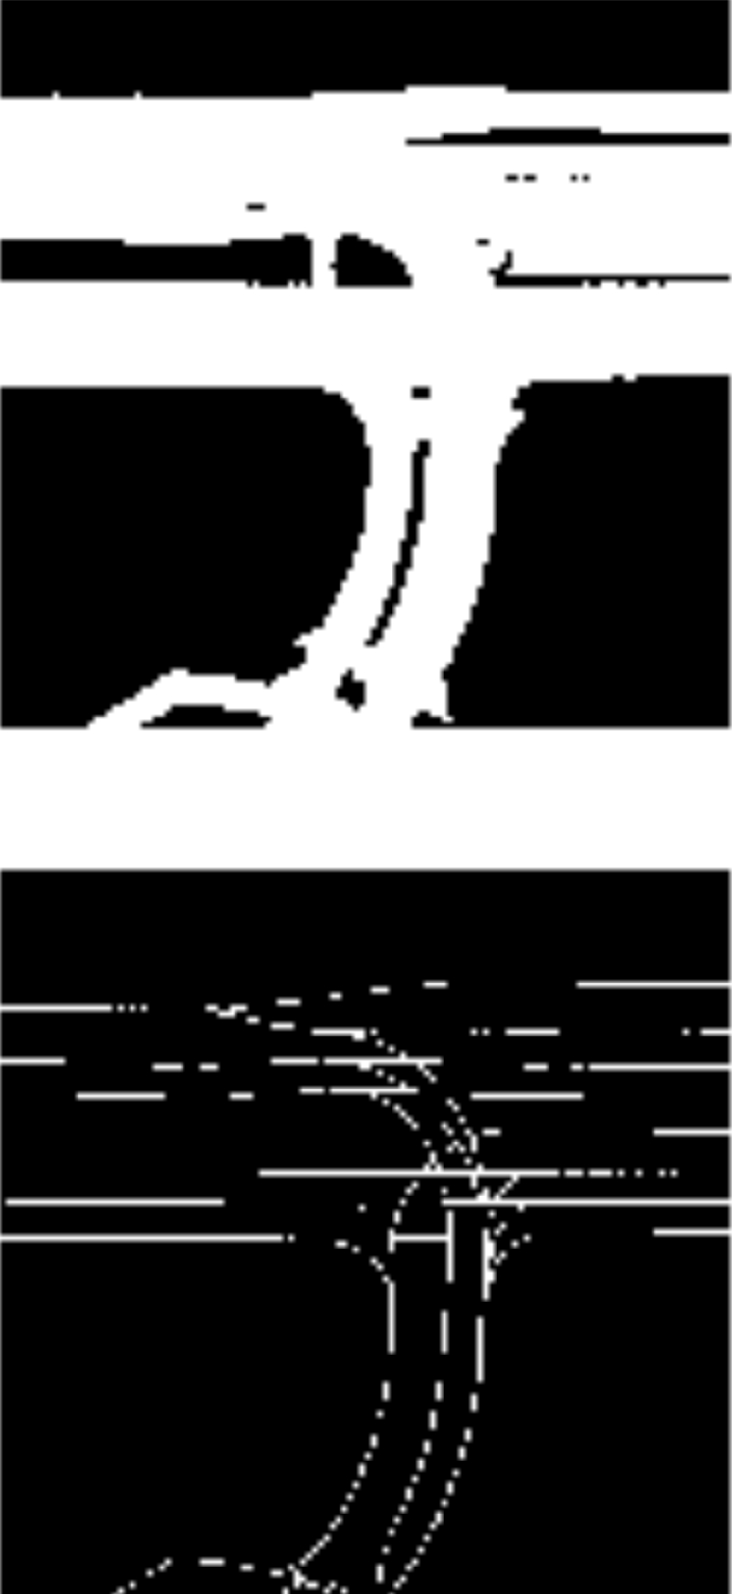
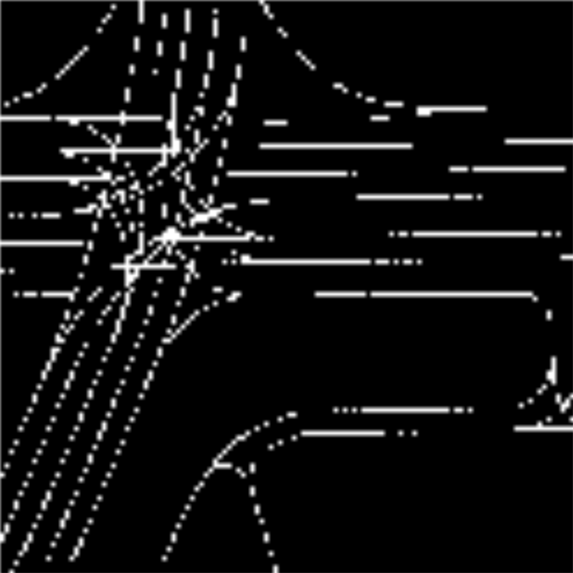
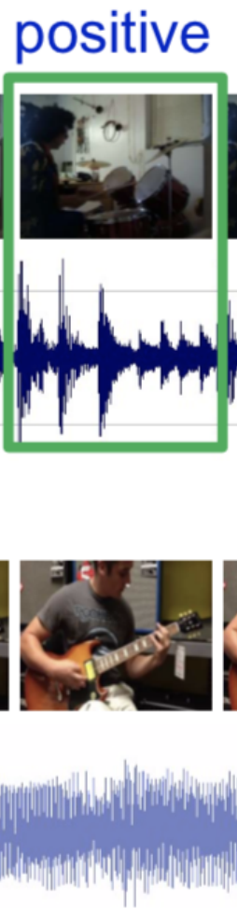
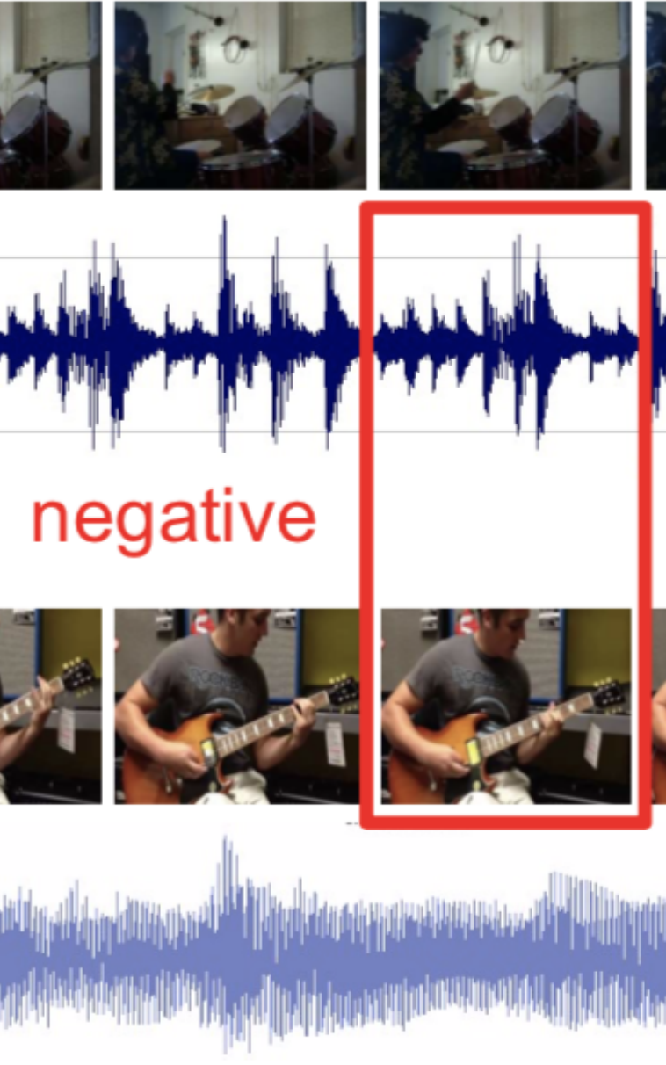
Using Extra Info (Lane Masks)
Using lane masks
No Pretrain | Lane + Road Segmentation | Lane → Road Correspondence
0.741 | 0.743 | 0.746
Notes:
We utilized the lane masks provided in 2 ways. Firstly, we designed a 6 encoders, 2 decoders architecture to predict both road and lane masks simultaneously. Secondly, and perhaps more interestingly, we designed a correspondence pretext task. Given 2 inputs, road mask and lane mask, the network had to predict if the two masks correspond. For instance, the road and lane masks in the left column correspond since they are taken from the same scene whereas the ones in the right column do not. This lane-road correspondence approach yielded better results.
Our team also decided to leverage the extra information provided to us in the form of lane masks. We utilized these lane masks in 3 ways. Firstly, we trained the 6 encoder network for lane segmentation and then transferred the weights for road segmentation. This achieved a lower threat score than one with no pretrain. Secondly, we designed a 6 encoders, 2 decoders architecture to predict both road and lane masks simultaneously. This approach achieved slightly better results than no pretrain. Thirdly, and perhaps the most exciting one, we designed a correspondence pretext task. Given 2 inputs, road mask and lane mask, the network had to predict if the two masks correspond. For instance, the road and lane masks in the left column correspond since they are taken from the same scene whereas the road and lane masks in the right column do not correspond since they are taken from different scenes. This idea was inspired from the objects that sound paper, where the task is to predict if the image and audio correspond. Out of the 3 approaches we tried, the lane-road correspondence approach yielded the best results, although not as good as we hoped for.

Slide 4
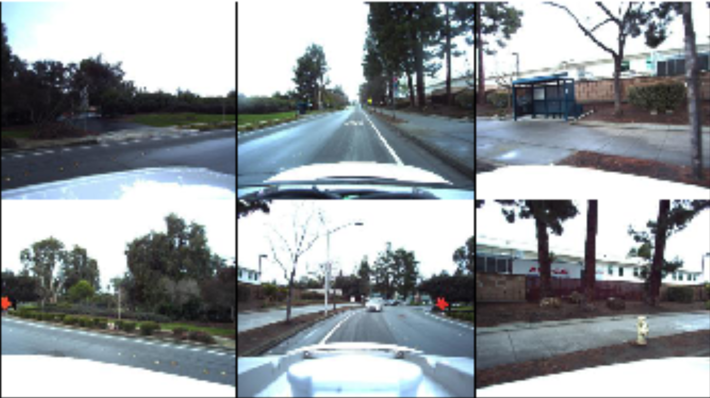
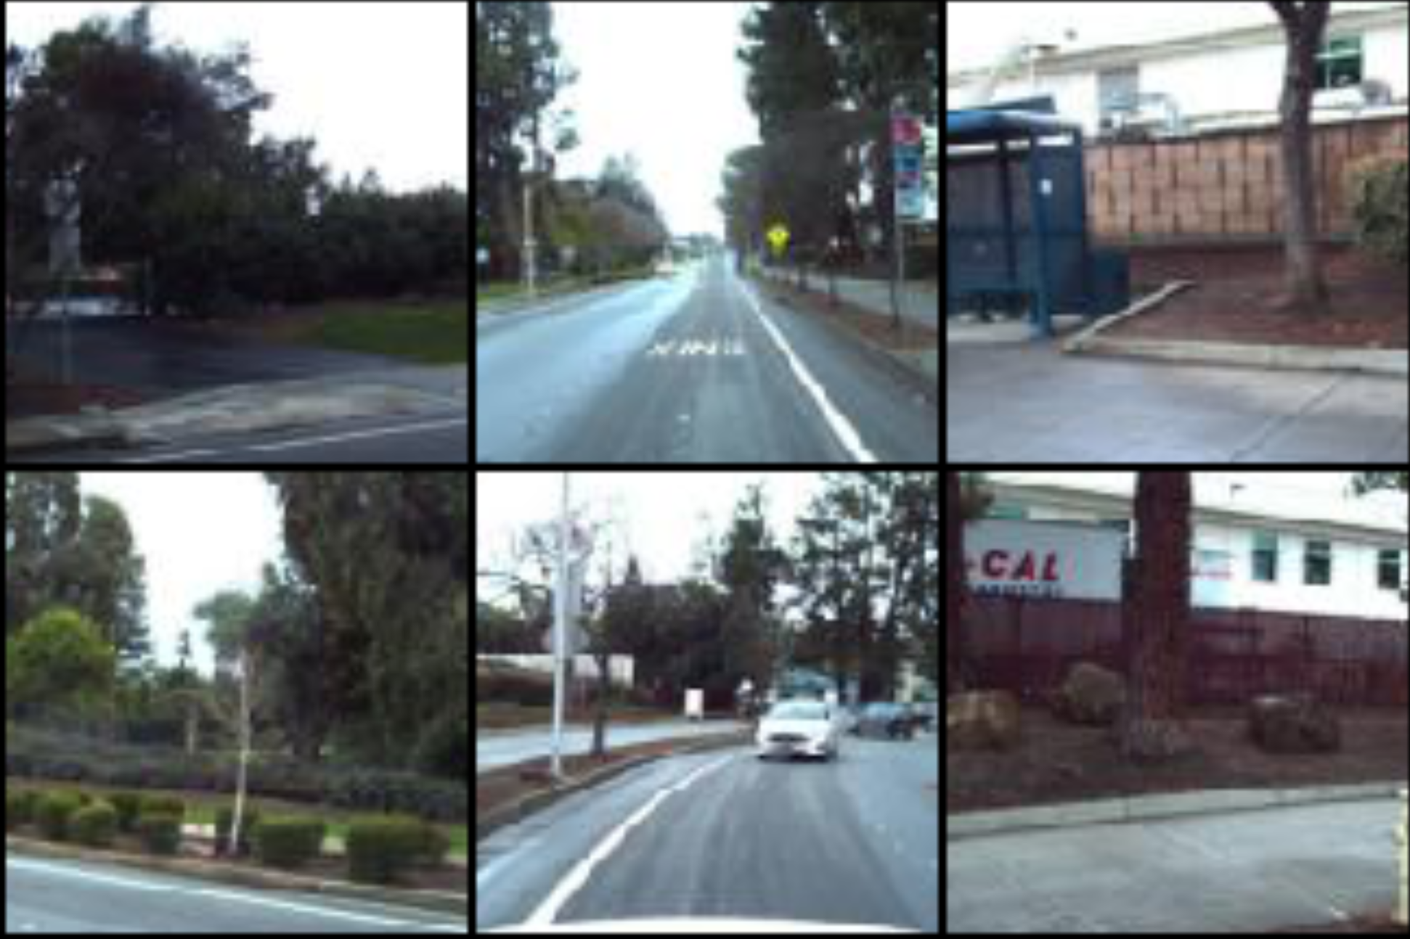
Self-Supervised Learning
Pretext tasks
No Pretrain | Jigsaw (700)* | Stereo (700)* | Jigsaw (1000)*
0.741 | 0.750 | 0.753 | 0.762
Stereo produces better results for equal number of permutations
* represents number of permutations
Notes:
For self-supervised, we used 2 pretext tasks: jigsaw and our own designed pretext task which we call stereo. In stereo, given a permuted sequence of images from the 6 cameras, the network has to predict the permutation. The intuition behind designing this task was the following: in order to accurately perform road segmentation for the entire scene, the network needs to know which camera represents which part of the scene. To make sure that the network does not learn from car's body and focuses on the scene, we cropped each image. Stereo produced better results for equal number of permutations. However, jigsaw produced better results for 1000 permutations.
Next, we utilized self-supervised pretext tasks in order to pretrain the network on the unlabeled dataset. Here, we used 2 pretext tasks: jigsaw and our own designed pretext task which we call stereo. Similar to the jigsaw idea, the task is the following: given a randomly permuted sequence of images from the 6 cameras, the network has to predict the permutation. The intuition behind designing this task was the following: in order to accurately perform road segmentation for the entire scene, the network needs to know which camera represents which part of the scene. However, the stereo pretrain network could simply cheat by learning the view of the car itself that is visible from the camera. Since this view of the car itself is fixed across different frames, the network would not learn anything about the scene itself. In order to avoid this, we crop each of the 6 images to the central 150 * 150 region, thereby removing any view of the ego-car from the images. In comparison to the jigsaw pretext task, pretraining with the stereo pretext task yielded better results when both methods were pretrained for 700 permutations. However, increasing the jigsaw permutations to 1000 yielded better results. For transfer learning, we experimented with 3 schemes: 1). training only the decoder and keeping the encoder weights fixed from the pretrain task, 2). Training both encoder and decoder with the same learning rate, 3). Training decoder with a higher learning rate than the encoder. The third strategy produced the best results.

Slide 5

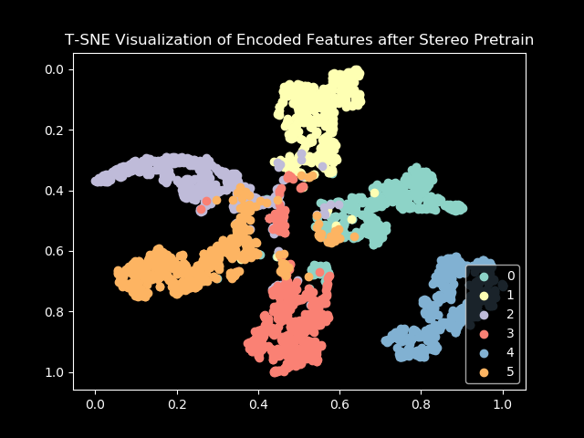

Visualizations
Predictions
Ground Truth
Notes:
The top row shows a nearly perfect road segmentation. The bottom row shows a fail case. In order to show that the stereo pretrain task helps the network learn the different camera views, we did a T-SNE visualization of the encoded features from the stereo pretrain network. The figure shows that the network clusters the feature representations for the 6 camera images in different regions of the latent space. Hence, it helps the network perform the road segmentation task since it can distinguish between the different camera views and match each camera view to a particular region of the output segmentation result.
The top row shows a case where the network performs nearly perfect road segmentation. The bottom row shows a fail case. This could perhaps be due to the fact that since the road in the center in present in nearly every scene, the network learns this easily. In contrast, the road at the bottom is not that prevalent and hence, the network struggles to accurately predict it. In order to verify our hypothesis that the stereo pretrain task does indeed help the network learn the different camera views, we did a T-SNE visualization of the encoded features from the stereo pretrain network. The figure shows that the network clusters the feature representations for the 6 cameras in different regions of the latent space, thereby helping the network perform the road segmentation task since it can distinguish between the different camera views and match each camera view to a particular region of the scene road segmentation result.

Slide 6
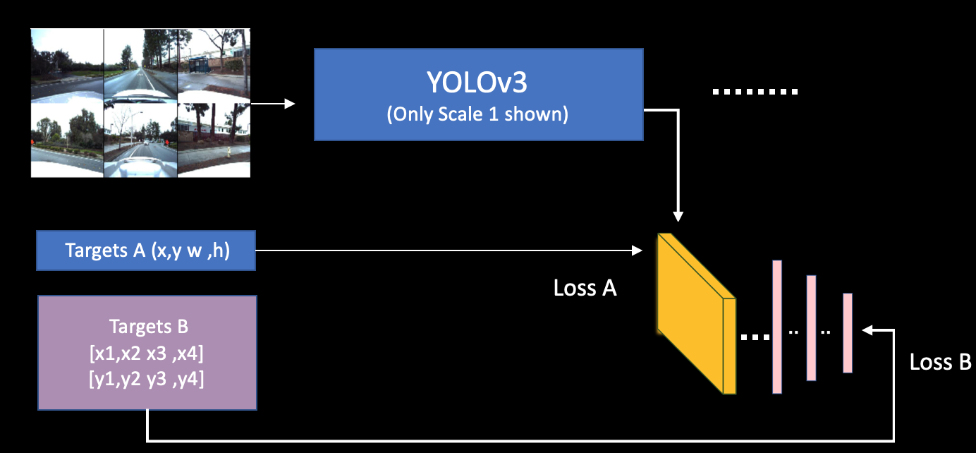
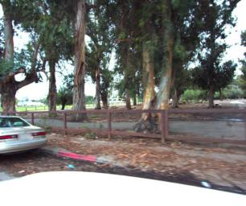
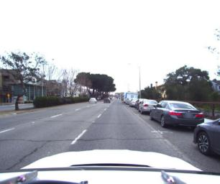
YOLOv3: Double Targets
Object Detection
Modified YOLOv3
Input types
Concatenated | Tiled
0.000143 | 0.000498
Total Loss = Loss A + Loss B
Architecture
Normal | Double Targets
0.000298 | 0.000498
Notes:
For objection detection, we began with modified YOLO v3 architecture. Firslty, our experiments showed that inputing tiled images compared with contatenates images gave us better results.
Secondly, we know that YOLOv3 normally accepts 4 targets of the bounding boxes: x, y , width and height. However, in our project, we are given 8 values of the targets which means that our bounding boxes can be tilted. In order to incorporate the idea of tilted boxes, we added a few linear layers after the yolo head to predict 8 values of coordinates.
Note that targets B are compared with the output of the linear layers, thus giving us Loss B. Whereas targets A are compared with the usual output giving us Loss A.
Finally, Total Loss is equal to Loss A and Loss B.
Therefore, adding these double targets improved our performance as shown in red color since we learned the representation of tilted boxes

Slide 7
Objection Detection: Faster R-CNN
Loss function Weights
Coordinates (Regression) | Objectness | Classifier | RPN Regression | Score
1.0 | 1.0 | 1.0 | 1.0 | 0.0096
5.0 | 1.0 | 1.0 | 1.0 | 0.0143
Notes:
However, our best results were achieved using Faster R-CNN.
We modified the loss function of the FRCNN and gave more weightage to the coordinates regression loss .
This is because in our problem, we do not care about the object class.
Thus, upon increasing the weight for coordinates loss to 5, we achieved our best threat score of 0.0143,

